Slide 1
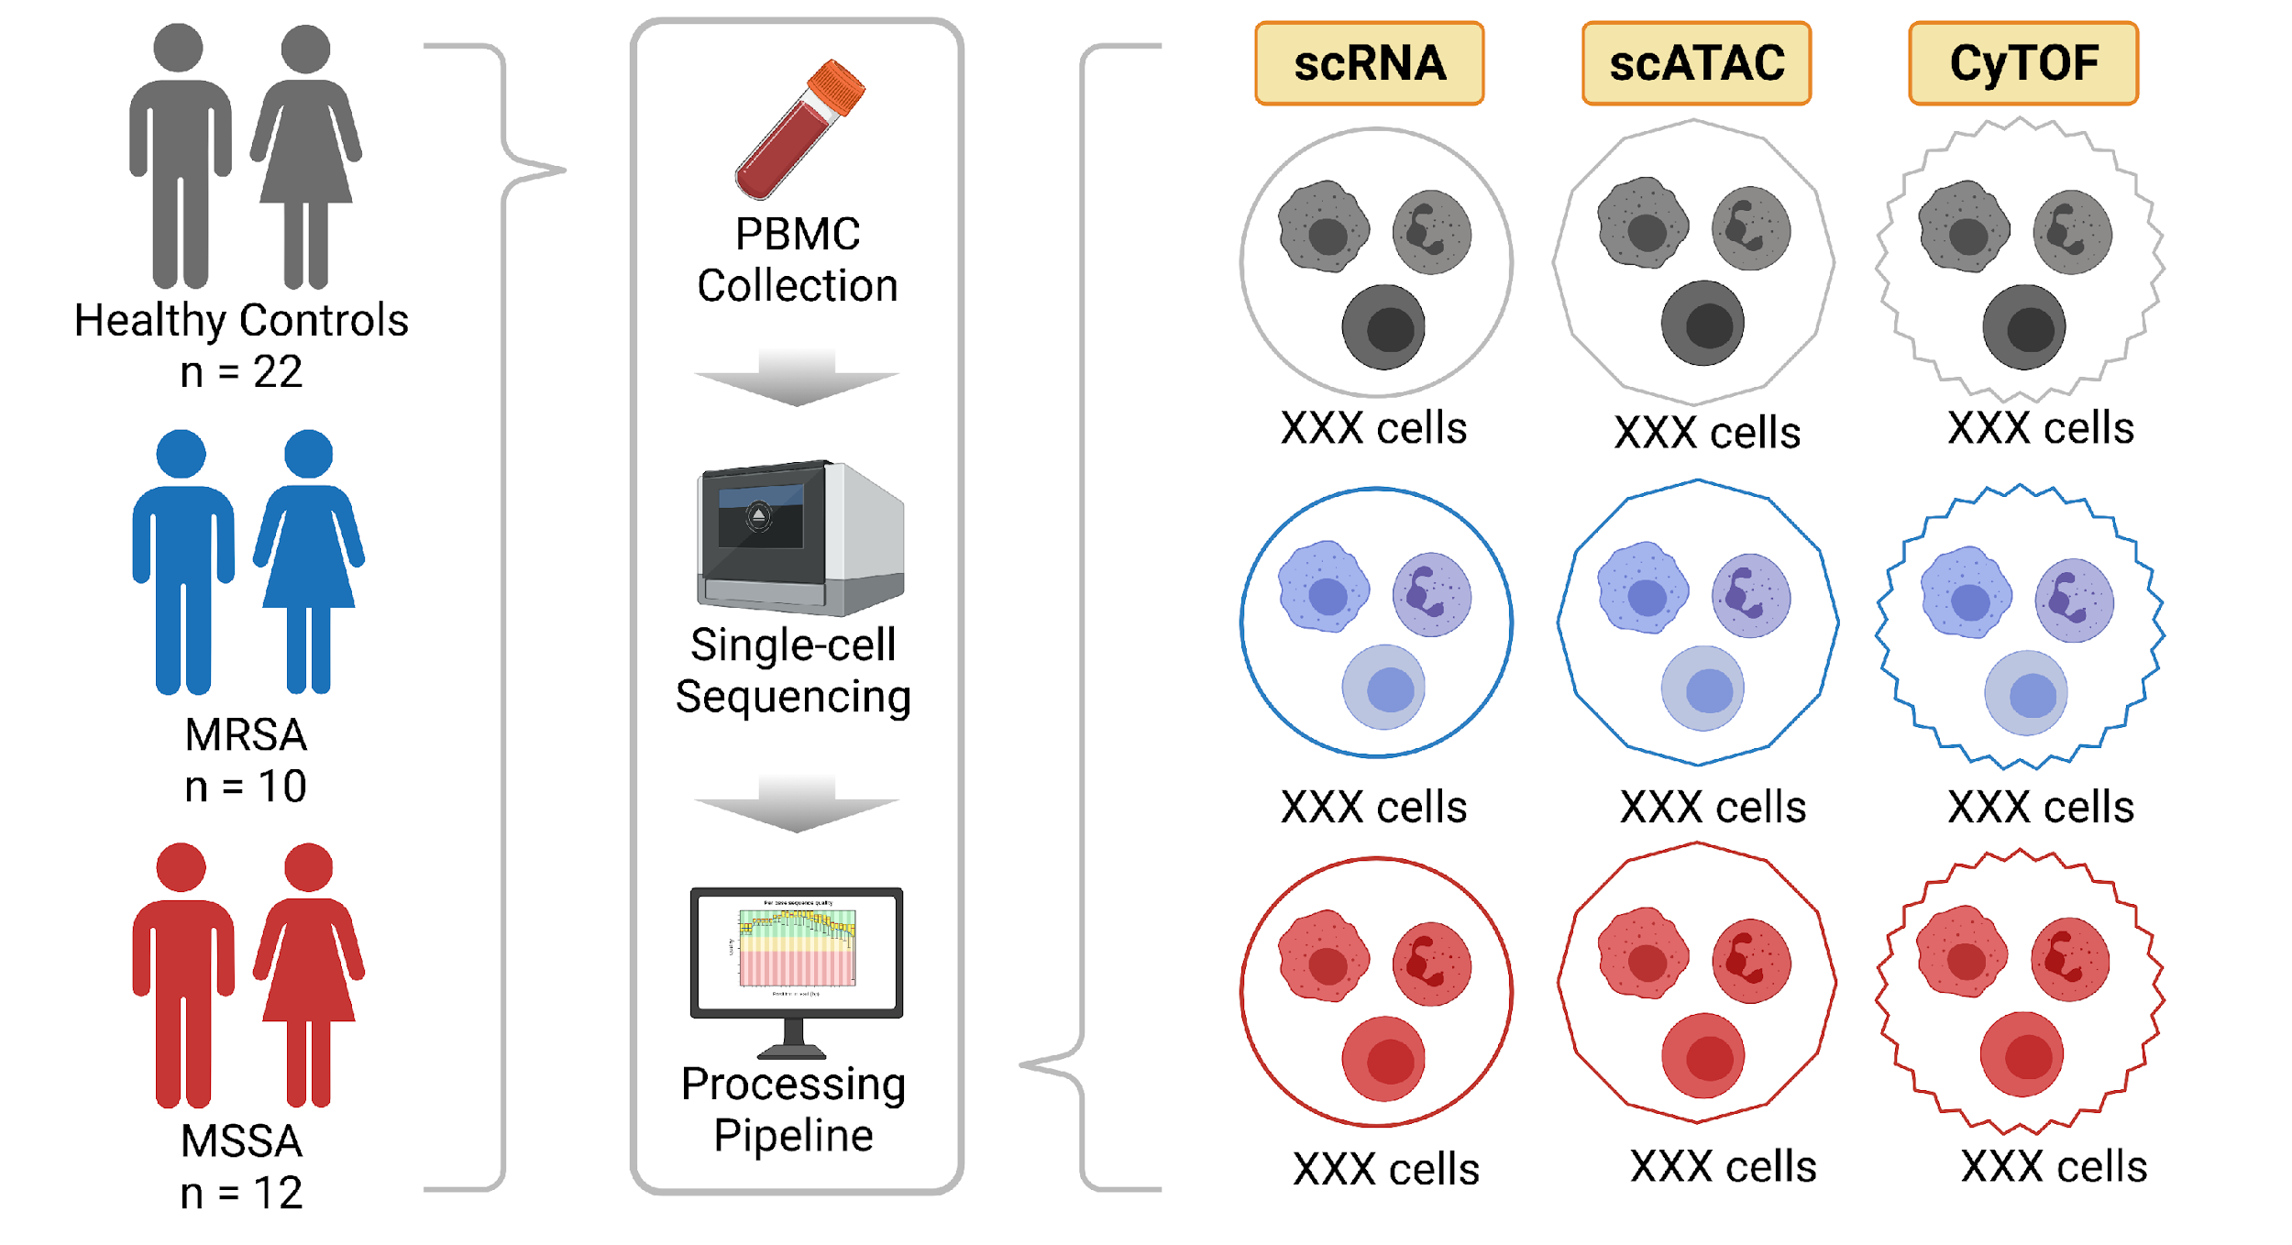
Pre-exposure
n = 6
Use MAGICAL to find set of epi-genes and associated regulatory peaks
f
Same sample: scRNA-seq (Seurat) and scATAC-seq (ArchR)
Downstream analyses using HumanBase
Same subject
MSSA
n = 12
Post-exposure
(28 days)
n = 6

